Slide 1
Rethinking the Language Center in the Age of Globalization: Structure
Mary Toulouse, Director Language Resource Ctr.
Lafayette College
Symposium at Yale, November 9 &10, 2012

Slide 2
Who Are We? …A Small Liberal Arts & Engineering College
2400 students
Undergraduates
Residential campus
Degrees:
BS,Engineering
BA, Engineering
BA, Liberal Arts
Part of Lafayette’s Mission is to provide “…programs that serve as platforms for innovative, project-based educational experiences that will add a global dimension to students’ abilities to work in diverse teams.” Wendy L. Hill, Provost and Dean of Faculty
Notes:
Overview
Lafayette is a small undergraduate institution—2400 students—offering degrees in Liberal Arts and Engineering
Serving a residential campus—don’t have as compelling a need for on-line courses & materials as institutions with commuters. Physical structures /needs are therefore different.
Global studies initiative as part of the mission statement.

Slide 3
2012 Language Requirement
All students must demonstrate elementary level proficiency of a foreign language.
Minimum score of 500 SAT
AP or IB score of 3 or better
Successful completion of a 101-102 sequence*
*Simple placement does not exempt a student from the requirement.
Notes:
Structure of the curriculum:
All students must demonstrate elementary level proficiency of a foreign language:
This includes engineering as well as liberal arts degree students.
Vote of confidence in what we have been doing, not just an idea of what we should be doing.
Classes are full—somewhat over capacity, some new sections. Resource Center is being fully used.

Slide 4
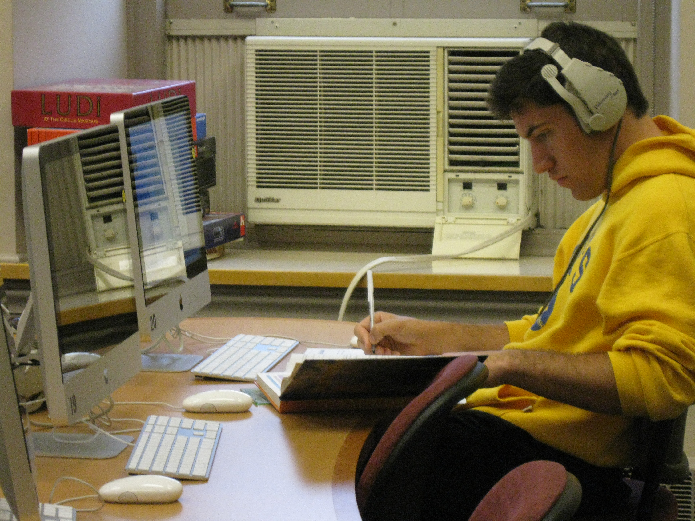
Bricks & Mortar Renovations
Notes:
Physical structures: PC seminar room and multi purpose classroom, drop-in center
Series of renovations from 2005 to 2007 .
Goal was to support a flexible teaching and learning environment.
New emphasis on encouraging collaborative learning.

Slide 5
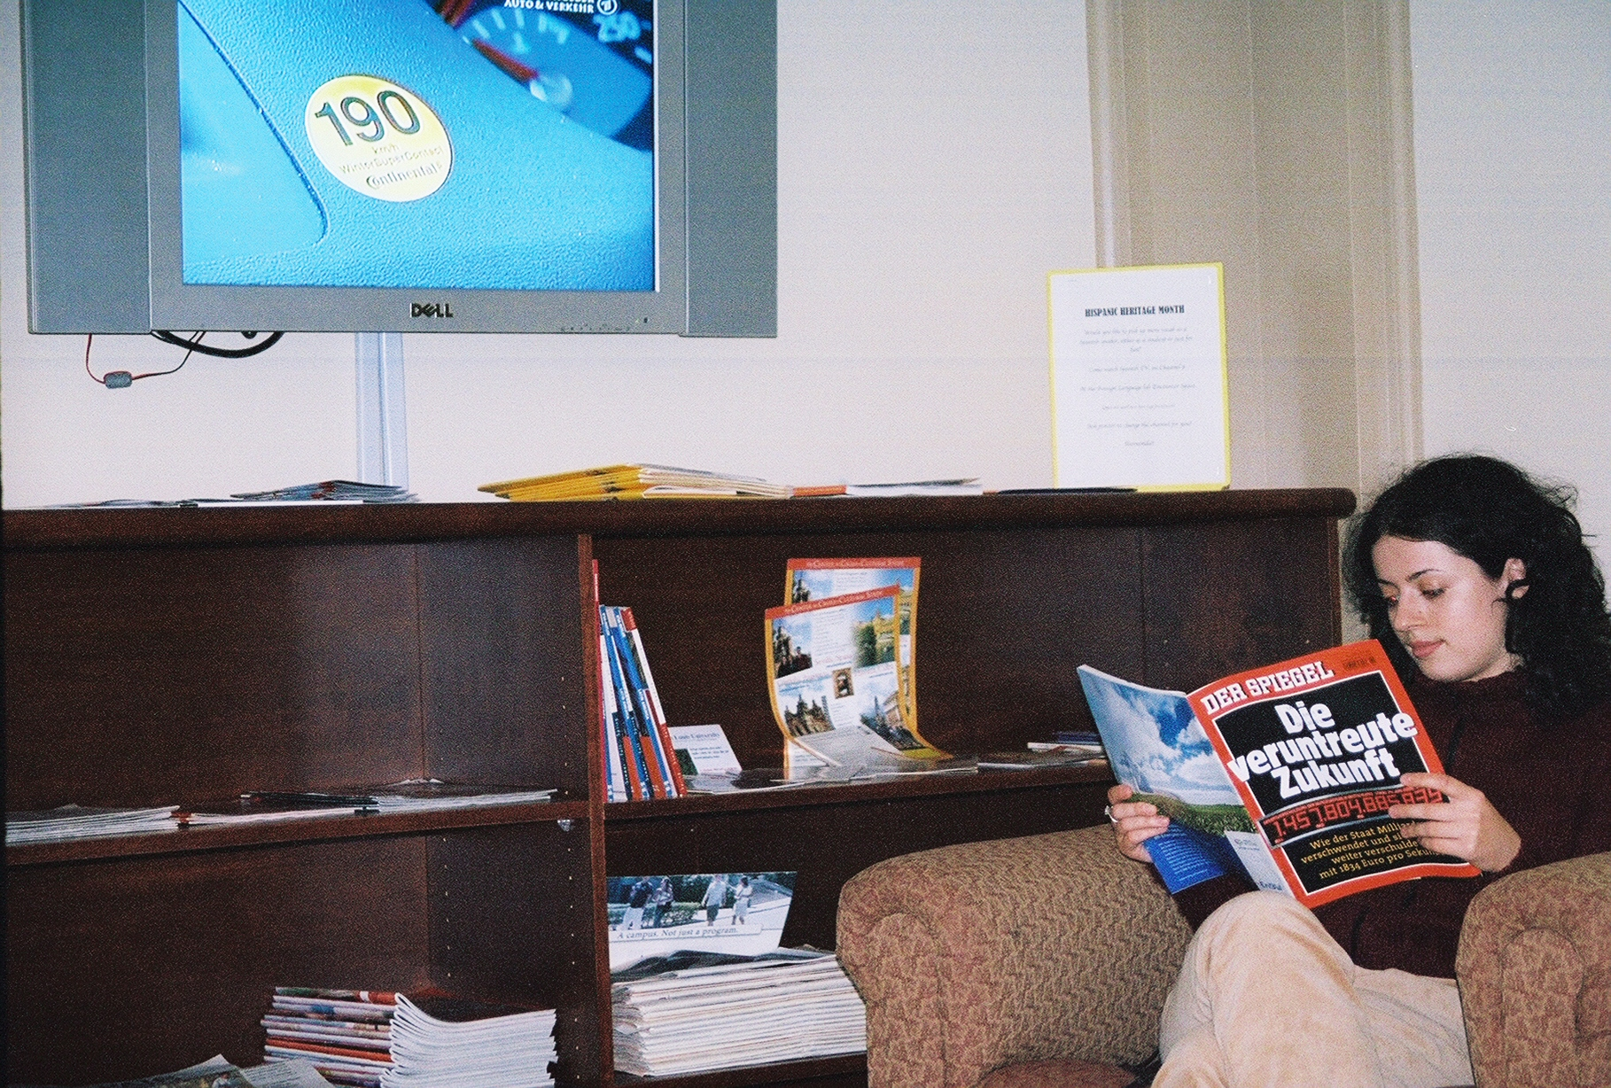
“Occupying” the 4th Floor of Pardee Hall
All language faculty offices
Multifunctional capabilities of RC
Formal and informal learning areas: lounges w/ media,video conferencing, encounter spaces
Notes:
Misfortune of being of being on the 4th floor of a building
Good fortune of having faculty and classrooms all grouped in the same place on the 4th floor.
Formal and informal learning areas :2 previously mentioned classroom area but also several lounges w/ media support
Possibilities for coffees, for tutorials, for small group and individual video conferencing.

Slide 6
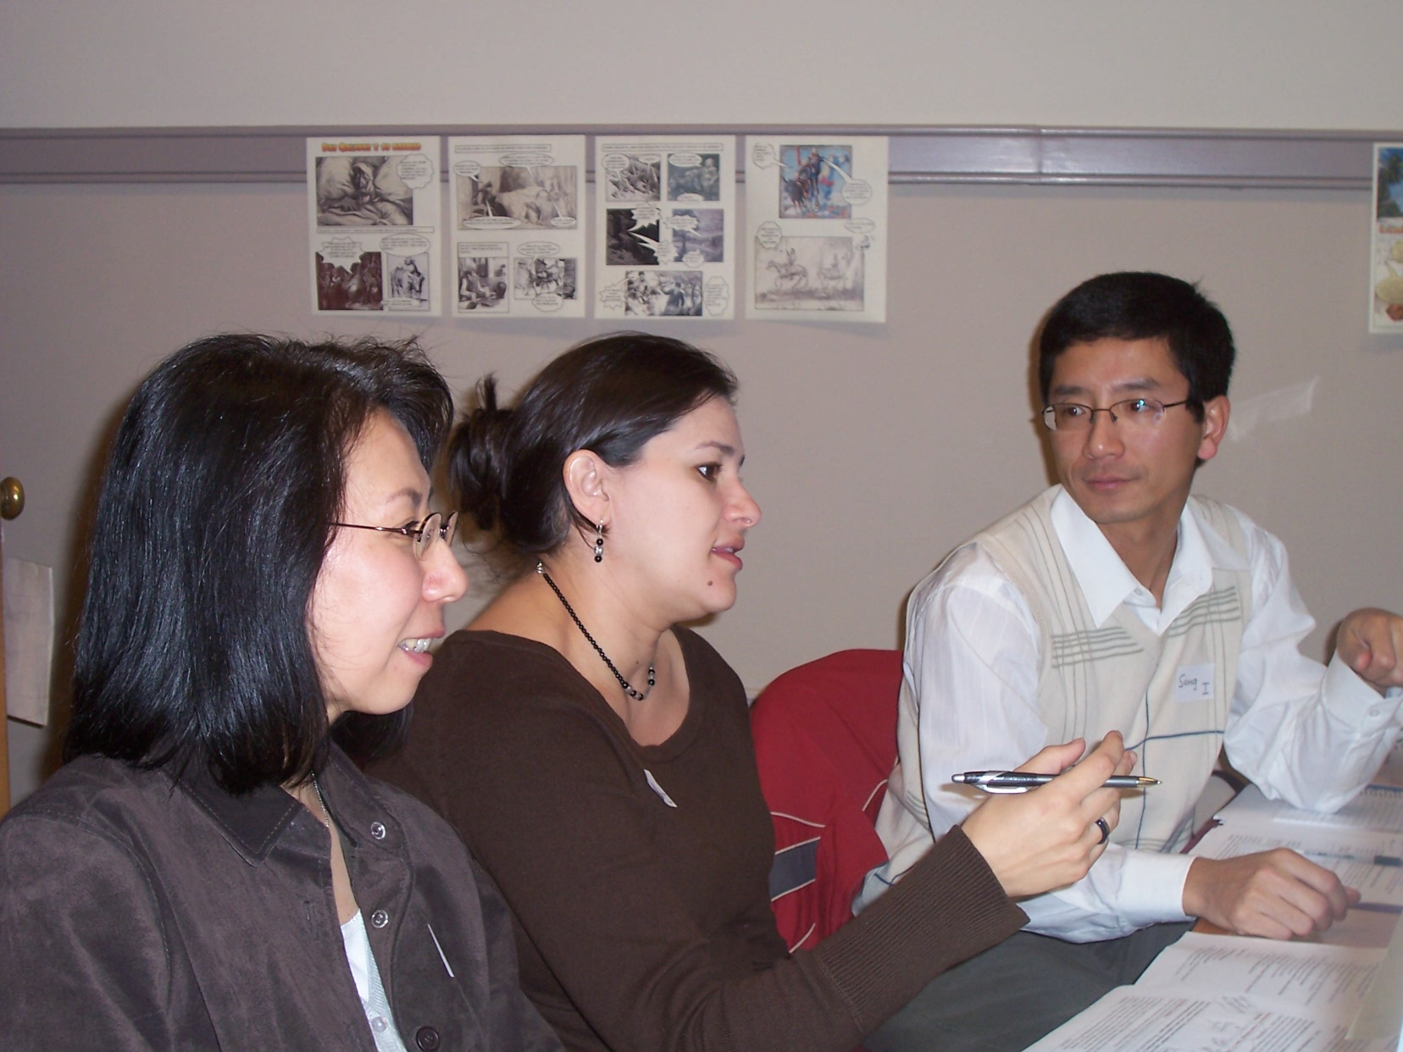
Space Used for Workshops to Encourage Faculty Innovation Across Languages
Internal funding (Alas! no DOE funding)
2 year period, outside speakers, workshops , e.g., OPI, multimedia
$1000 per faculty participant: develop one module, attend 3 of 4 workshops
Goal: promote “proficiency-based” teaching & learning
Participants produces modules with emphasis on providing evidence of student proficiency
Notes:
Internal funding (Alas! no DOE)
Workshops designed by departmental specialists in pedagogy for faculty. Most faculty degrees in literature, film, or history.
2 year period, outside speakers, workshops (OPI)
$1000 per faculty participant: develop one module $$$$$
Emphasis on “proficiency-based” teaching & learning: main challenge. All faculty members + professionals and design their own curriculum; no coordinator.
** no bifurcation of literature & languages (upper level documentaries, recordings of interviews, creative writing assignments as well as elementary level readings)
Strong pull to remove our LCT faculty and put them in area studies departments housed in the Religion or History Depts
All takes place in the FLLRC, initiative comes from the FLLRC

Slide 7
Coalition of the Willing
Participation in all languages taught at Lafayette (Chinese, Japanese, Hebrew, French, Spanish, German, Russian).
Notes:
Participation in all languages taught at Lafayette (Chinese, Japanese, Hebrew, French, Spanish, German, Russian).
Not required participation but had strong support by faculty—80% of classes have proficiency components encompassing 3 modes of communication.

Slide 8
Virtual Spaces
Tools:
Can-Do proficiency self-assessments
e-Portfolio
Guided Independent Studies Courses (GILS) for the less-commonly-taught languages
No Web courses; WEB courses are not eligible for credits,
Notes:
Dabble in some Cloud computing/ develop a virtual presence

Slide 9
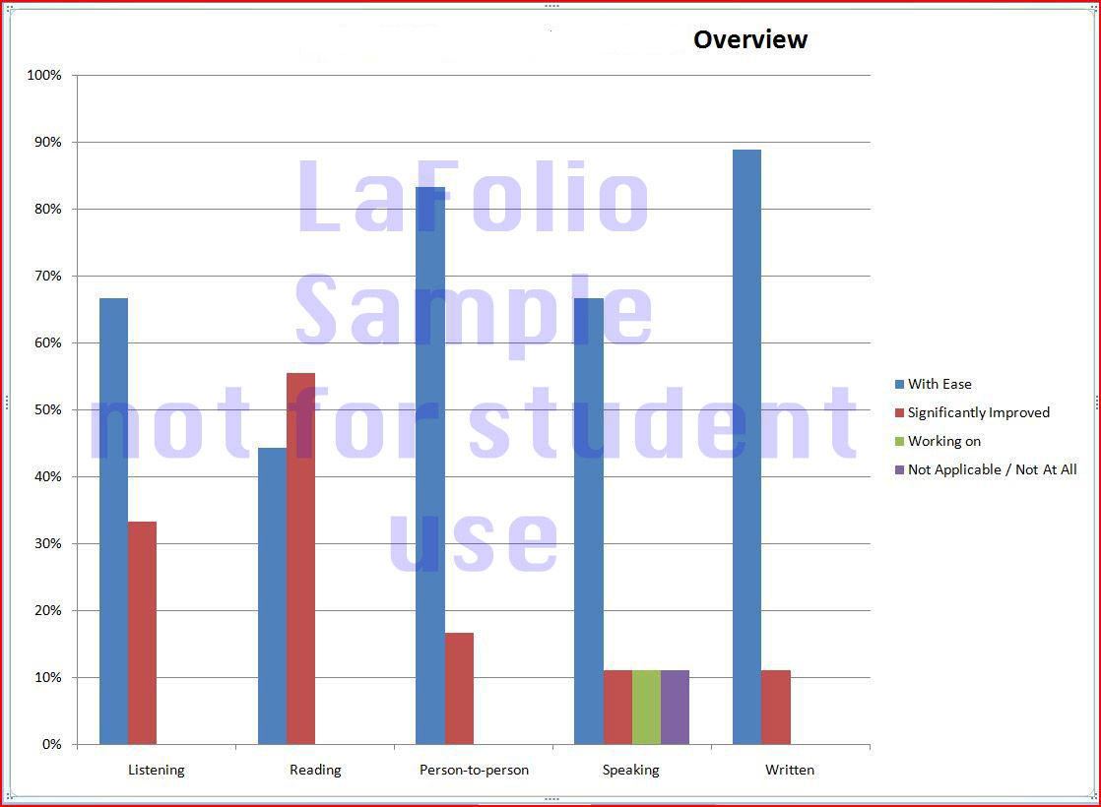
CanDo’s
Student self-assessments of proficiency
Based on ACTFL & CEFR 5 modes of communication
Customized electronic version
(Google Templates: LaFolio)
Visual Summaries of results for faculty evaluation of courses & students’ progress.
**Formative Assessment: CanDo’s generate regular discussion and modification of LAF curricular goals and new teaching practices.
Notes:
CanDo’s =Structures for class assessment:
Student self-assessments of proficiency, NOT used in their grades nor in the formal faculty evals. Just some dept research on curriculum.
Based on ACTFL & CEFR 5 modes of communication
Customized to Lafayette’s curriculum. Produced in electronic version (Google Templates: laFolio) for ease of distribution
Results provide VISUAL summaries of data results for faculty & students
**CanDo’s generate regular discussion of LAF curricular goals and new teaching practices. In terms of formative assessment, effective addition to our programs.

Slide 10
e-Portfolio
Template
Documents Experiences
Study abroad (blogs)
Service
Archives evidence of language proficiency
Encourages interdisciplinary studies
Charts progress
Blueprint
Capstone Assessment
Provides formative & summative assessments
Notes:
Structure: Assessment of outcomes and programs
beta testing e-Portfolios (200 at this point covering all levels)
Charts progress
Blueprint: encourage students to make use of their languages in other disciplines
Capstone Assessment
Documents Experiences
Study abroad (blogs)
Service: engineers without borders, work in the honor societies
Presents evidence of language proficiency,e.g., papers, recordings, videos, interviews
Encourages interdisciplinary studies: e.g., Student in sample felt that the courses that most defined him—Spanish, History , Women’s & Gender Studies
Provides formative & summative assessments
How does it work? Each indiv instructor grades work from own course, but >>moving towards including this as a capstone course> others see the total portfolio>>work as a team as a dept
Courses: each instructor assesses the work

Slide 11
Badges
Assessment based on AAC&U rubrics
Indicate benchmark achievements:
Gold
Silver
Ruby
Promote Inter-disciplinary / intra- curricular learning
Foster student reflections
Evaluated by faculty panel
Notes:
Assessment through the ePortfolio:
We beta tested using Badge technology: Badges served as links to customized AAC&U rubrics and ACTFL to language study
Gold, silver, ruby represent milestones in achievement
Example: Cultural self-awareness: Recognizes new perspectives about own cultural rules and biases
Empathy: Interprets intercultural experience from the perspectives of more than one worldview and acts in a supportive manner
Knowledge in an intercultural context: Demonstrates adequate understanding of the complexity of elements important to members of another in the following domains: history, values, politics, communication styles, economy, or beliefs and practices. Evidence includes one signature artifact related to at least three fields of study, e.g., languages, social sciences, humanities, natural sciences and/or engineering. language

Slide 12
Synergy Between The Virtual & Concrete

