Slide 2
University of Wisconsin-Madison
Est. 1848
Flagship public university of State of Wisconsin
42,000+ students (grad, undergrad, prof)
108 PhD programs, 150 master’s programs, 157 undergraduate majors
4,000 courses

Slide 3
Mission
Provide “a learning environment in which faculty, staff and students can discover, examine critically, preserve and transmit the knowledge, wisdom and values that will help insure the survival of this and future generations and improve the quality of life for all. The university seeks to help students to develop an understanding and appreciation for the complex cultural and physical worlds in which they live and to realize their highest potential of intellectual, physical and human development.

Slide 4
Wisconsin Idea
1904, UW-Madison President Charles Van Hise
Extend “the beneficent influence of the university [to…] every home in the state.”

Slide 5
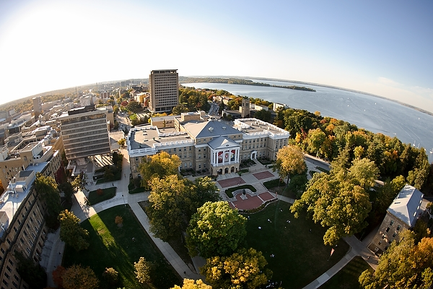
Notes:
Languages today are housed in Van Hise Hall. Wisconsin Idea informs much of what we do.

Slide 6
Departments Offering Languages
African Languages and Literature American Indian Studies
Anthropology
Classics
East Asian Languages and Literature
English
French and Italian
German
Hebrew and Semitic Studies
Languages and Cultures of Asia
Linguistics
Scandinavian Studies
Slavic Languages and Literature
Notes:
12 depts/progrms

Slide 7
Languages Taught in AY 2012-13
Akan (Twi)
Arabic
Chinese
Czech
Danish
Dutch
ESL
Filipino
French
German
Greek (Ancient)
Hebrew, Biblical
Hebrew Modern
Hmong
Icelandic
Irish
Italian
Japanese
Kazak
Korean
Latin
Norwegian
Pashto
Persian
Polish
Portuguese
Quechua
Russian
Sanskrit
Serbo-Croatian
Spanish
Swahili
Swedish
Thai
Tibetan
Turkish
Urdu
Vietnamese
Yoruba
Yucatec Maya
Zulu
Notes:
41 languages

Slide 8
Area and Global Studies
*African Studies Program
*Center for East Asian Studies
European Studies Alliance
*Center for European Studies
European Union Center of Excellence
Center for German and European Studies
Center for Interdisciplinary French Studies
Global Studies Coalition
*Global Studies
Global Cultures Program
International Studies Major
Development Studies
*Latin American, Caribbean and Iberian Studies Program
Middle East Studies Program
*Center for Russia, East Europe and Central Asia
*Center for South Asia
*Center for Southeast Asian Studies *Title VI NRC
Notes:
FLAS
8 NRCS

Slide 9
2012 Summer Language Institutes
APTLII: Arabic, Persian, Turkish
CESSI: Kazak, Tajik, Uyghur, Uzbek
SASLI: Bengali, Gujarati, Hindi, Malayalam, Marathi, Pashto, Sanskrit, Sindhi, Sinhala, Tamil, Telugu, Tibetan, Urdu
SEASSI: Burmese, Filipino, Hmong, Indonesian, Javanese, Khmer, Lao, Thai, Vietnamese
+ Courses in ASL, French, German, Japanese, Latin, Russian, Spanish…

Slide 10
Language Institute
Est. 2003-4
College of Letters and Science and Division of International Studies
Founding director: Sally Magnan (2004-11); current interim director: Junko Mori (2011-13)
Founding associate director: Dianna Murphy (2004-present)

Slide 11
Language Institute: Mission
Promote collaboration for research, education, and outreach in languages, literatures, and cultures

Slide 12
The Language Institute: Mission
Promote collaboration for research, education, and outreach in languages, literatures, and cultures

Slide 13
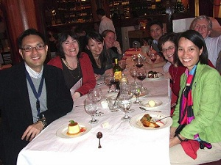
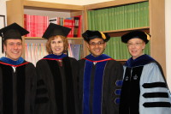
Education Academic Programs
PhD Program in
Second Language Acquisition
Russian Flagship Center
With the Department of Slavic Languages and Literature
Funded by the National Security Education Program

Slide 14
Education Online Curriculum and Instructional Materials Development Projects
Russian
Swahili
LCTL teacher training
Kazak and Uzbek
Business Chinese
Chinese courses for high school students

Slide 15
Education Programming for Faculty, Instructional Staff and Graduate Students
Lecture Series “Language, Cognition, and Sociality” (2012-13)
“Cosmopolitanism and Language” (2011-12)
“Immersion and Language Learning” (2010-11)
“Language and Migration” (2009-10)
“Culture, Literature, and Language” (2008-09)
Second Language Acquisition Talk Series
Workshops for language instructors

Slide 16
Education Programming for Faculty, Instructional Staff and Graduate Students
Brownbag series: Language Over Lunch
Presentations of research in progress by faculty and graduate students
Presentations of “best practices”
Panel discussions on curricular and instructional innovations
Panel discussions on research methods and professional development

Slide 17
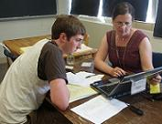
Education Undergraduate Advising
International Directions Advisor
New position created in 2012 with the Madison Initiative for Undergraduate (MIU) Fund.
Offer academic and career advising to undergraduate students who are interested in languages and international area studies.
Assist students and other advisors to navigate the many language learning opportunities on campus.

Slide 18
Education Programming and Resources for Undergraduates
Language for Life
Languages and Business
Languages and Professional Opportunities in National Security and Intelligence
Languages and Global Health
Languages and Engineering
Languages and Medicine
Careers in Translation and Interpretation
Languages and Environmental Careers
Languages and Law

Slide 19
Education Programming and Resources for Undergraduates
Workshops and panel discussions
Strategies for Language Learning
Marketing Your Language Skills
Improving Your Language Skills While Studying Abroad

Slide 20
Education (Advocacy) Programming and Resources for Undergraduates
Profile: UW-Madison Students and Alumni of Languages

Slide 21
Education (Advocacy)

Slide 22
The Language Institute: Mission
Promote collaboration for research, education, and outreach in languages, literatures, and cultures

Slide 23
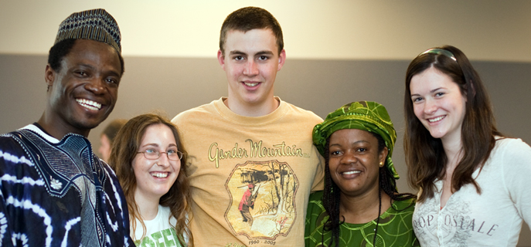
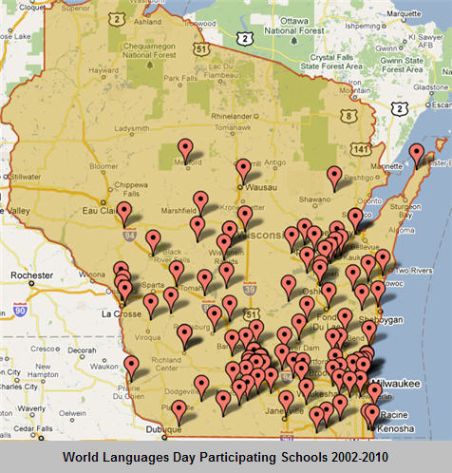
Outreach
World Languages Day

Slide 24
Outreach
World Cinema Day
College for Kids
Visits to schools; coordination of school visits to campus

Slide 25
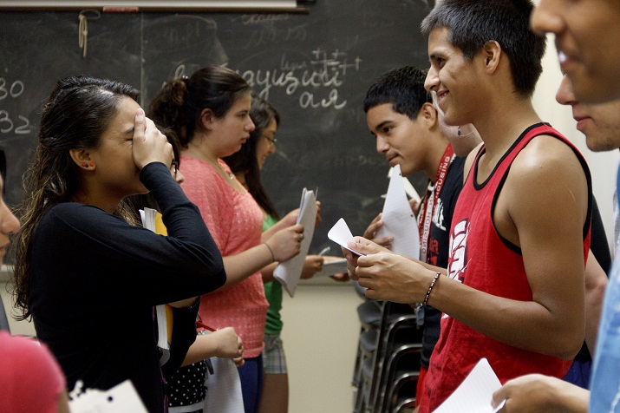
Pushkin Summer Institute (Flagship)

Slide 26
The Language Institute: Mission
Promote collaboration for research, education, and outreach in languages, literatures, and cultures

Slide 27
Research
Student goals, expectations, and the U.S. Standards for Foreign Language Learning
Student and tutor perceptions of tutoring in a Russian Flagship Program
The impact of study abroad on the global engagement of alumni
Reasons students take courses in more and less commonly taught languages
Notes:
Disciplinary

Slide 28
Future Mission?
Disciplinary focus
Focus on language teaching and learning?
Expand activities in line with current mission?
Broaden disciplinary focus (language studies: linguistics [theoretical and applied], first and second language acquisition, communicative disorders, etc.)?
Collaboration for what purpose?
Notes:
Disciplinary

Slide 29
Notes:
Challenges

Slide 30
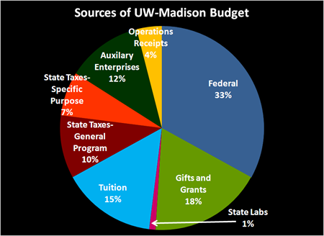
Fiscal Challenges
What happens if/when Title VI funding goes away?
Notes:
http://www.uwalumni.com/?sectionpath=1&pageid=20143

Slide 31
Notes:
efficient and effective approaches to instruction, administration, and communication.

Slide 32
2012-13: Considering Future Directions
Language Institute self-study
Task force on “future of languages”
Calls for educational innovations, restructuring, merging, efficiencies
Revisiting discussion of a school/division of languages: ?
Future role of the Language Institute on campus: ?

